Slide 1
Computer Organization تنظيم الحاسوب
Dr. Mahmoud Masadeh
BSc : CE, Hijjawi, YU, Jordan, 2003
MSc: CE, TUDelft, the Netherlands, 2013
MSc: MIS, AABFS, Amman, Jordan, 2009
PhD: ECE, Concordia, Montreal, Quebec, CANADA, 2020

Slide 2

Computer Organization- Administration
mahmoud.s@yu.edu.jo
Phone: 027211111 Ext:4408
Office: Hijjawi Old building, 4th floor, Office#428
Grading system:
Attendance is compulsory.
Midterm 30%
Quizzes, Homework, Tasks: 20%
Final: 50%
OPEN BOOK

Slide 3
Computer Organization
Textbook: Computer Organization and Design RISC-V Edition,
1st Edition, The Hardware Software Interface

Slide 4
Computer Organization
Computer Performance:
Mobile devices/ PC/ Embedded system (ES)/ Server:
Big-data:
Power-wall
Memory-wall:
System-level design
Component-level design:

Slide 5
About the Book
Whether your primary interest is hardware or software, computer science or electrical engineering, the central ideas in computer organization and design are the same.
For programs to run faster, they must become parallel.
The goal of many researchers is to make it possible for programmers to be unaware of the underlying parallel nature of the hardware they are programming. However, it will take many years to realize this vision.
The audience for this book includes:
Readers with little experience in assembly language or logic design who need to understand basic computer organization .
Readers with backgrounds in assembly language and/or logic design who want to learn how to design a computer or understand how a system works and why it performs as it does.

Slide 6
Computer Organization
Textbook: “Computer Organization and Design RISC-V Edition, The Hardware
Software Interface”, 1st Edition
Computer: Personal computer (PC), Embedded system(ES)
Organization: Understand the overall basic computer hardware structure, including the peripheral devices.
Design: The structure in which components relate to each other /Determining what hardware should be used and how the parts should be connected.
Architecture: Set of rules and methods that describe the functionality, organization, and implementation of computer systems / The science and art of selecting and interconnecting hardware components to create computers that meet functional, performance and cost goals.
RISC-V: Reduced Instruction Set Computer vs Complex Instruction Set Computer (CISC)
ARM: Arm is the leading technology provider of processor IP, offering the widest range of cores to address the performance, power, and cost requirements of every device, e.g., Cortex-A, Cortex-M, Cortex-R
MIPS: MIPS Processors, Widely used and backed by an active ecosystem of hardware and software partners, MIPS processors are the CPU of choice for the future of computing.

Slide 7
Why RISC-V for This Edition?
Computer Architecture, A Quantitative Approach :
The authors invented their own RISC-style instruction set.
Then switched to MIPS for almost 20 years
Now, it’s been hard to find a real computer on which readers can download and run MIPS programs.
RISC-V, which was developed originally at UC Berkeley, it cleans up the anomalies of the MIPS instruction set. Also, it offers a simple, elegant, modern example on what instruction sets should look like.

Slide 8
Why RISC-V for This Edition?
https://riscv.org/
There are open-source RISC-V simulators, compilers, debuggers
More than 40 companies have joined the RISC-V foundation, including AMD, Google, Hewlett Packard Enterprise, IBM, Microsoft, NVIDIA, Oracle, and Qualcomm
https://www.cs.cornell.edu/courses/cs3410/2019sp/riscv/interpreter/
https://www.kvakil.me/venus/

Slide 9
Table of Contents
Appendix A: The Basics of Logic Design (Self-Study)
Ch1: Computer Abstractions and Technology
Ch2: Instructions: Language of the Computer
Ch3: Arithmetic for Computers
Ch4: The Processor
Ch5: Exploiting Memory Hierarchy
Ch6: Parallel Processors from Client to Cloud (last semester we did not cover it)
Mid-term exam
Final exam

Slide 11
A. The Basics of Logic Design
A.2: Gates, Truth Table, and logic equations.
A.3: Design combinational circuits.
A.4: Hardware description language (HDL)
A.5: How to design an ALU for the RISC-V processor
A.6: How to make a fast adder: CLA
A.7: Introduction to the topic of clocking, which is necessary to discuss how memoryelements work.
A.8: Introduces memory elements (FFs, lateches, registers).
A.9: Focus on random access memories
A.10: Finite-state machine (FSM)
A.11: Timing methodologies
A.12: Field programmable devices

Slide 12
A.2 Gates, Truth Tables, and Logic Equations
Digital circuit can be described by various methods including:
Circuit Diagram
Truth Table
Logical equations

Slide 13
Combinational Logic
Decoder: A logic block that has an n-bit input and 2^{n} outputs, where only one output is asserted for each input combination.
Encoder
Multiplexors
De-Multiplixer

Slide 14
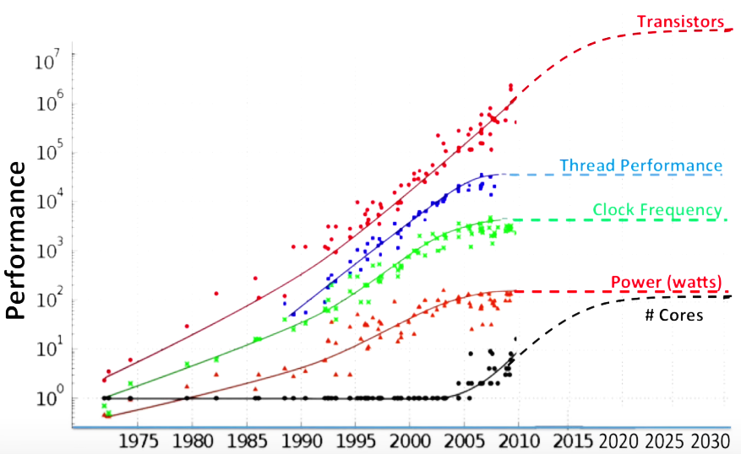
Computers’ Performance
The amount of useful work accomplished by a computer system.
The performance of a computer is dependant on how well it works together as a whole.
Upgrading one part of the computer while leaving outdated parts installed will not improve performance much, if at all

Slide 15
This first chapter lays the foundation for the rest of the book

Slide 16
1.1 Introduction
Computers are the product of information technology (IT) industry, which is responsible for almost 10% of the gross national product (GNP) of the United States.
Gross National Product (GNP) is the total value of all finished goods and services produced by a country's citizens in a given financial year.
In the last 30 years, several new computers have been introduced and revolutionized the computing industry.
Computers have led to a third revolution for civilization, with the information revolution taking its place alongside the agricultural and industrial revolutions.

Slide 17
1.1 Introduction
In the recent past, the following applications were science fiction:
Computers in automobiles: Computers reduce pollution, improve fuel efficiency via engine controls, and increase safety through blind spot warnings, lane departure warnings, moving object detection, and air bag inflation to protect occupants in a crash.
Cell phones: More than half of the planet having mobile phones
World Wide Web: The web has transformed our society
Human genome project: Computer equipments map and analyze human DNA sequences
Search Engines: the web grew in size and in value. Thus, finding relevant information became increasingly important.

Slide 18
Classes of Computing
Personal computers (PCs): delivery of good performance to single users at low cost and usually execute third-party software.
Servers: Oriented to carrying sizable workloads. Compared to PCs, it provides greater computing, storage, and I/O capacity. Higher dependability.
Supercomputers: Used for high-end scientific and engineering calculations. Consist of tens of thousands of processors and many terabytes of memory, and cost tens to hundreds of millions of dollars
Embedded computers: largest class of computers and span the widest range of applications and performance. Despite the large number of embedded computers, most users never really see that they are using a computer!

Slide 19
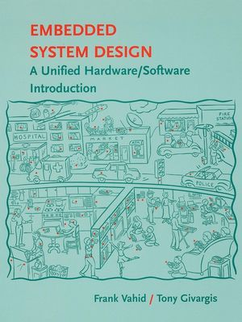
Embedded Systems
Embedded applications often have unique application requirements that combine a minimum performance with stringent limitations on cost or power.
Despite their low cost, embedded computers often have lower tolerance for failure, since the results can vary from upsetting (a new television crashes) to devastating (the computer in a plane or cargo ship crashes).
The emphasis is on doing one function as perfectly as possible.

Slide 20
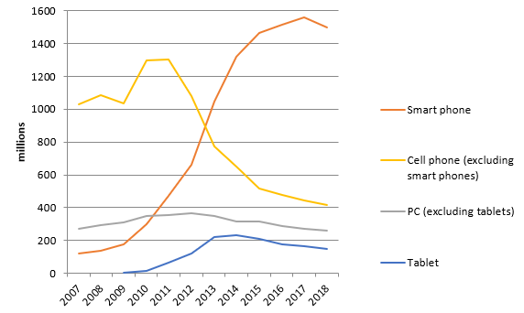
Post-PC Era
The Post-PC era is a market trend observed during the late 2000s and early 2010s involving a decline in the sales of personal computers (PCs) in favor of post-PC devices; which include mobile devices such as smartphones and tablet computers as well as other mobile computers such as wearable and ubiquitous ones.

Slide 21
Post-PC Era
PC, then Personal mobile device (PMD): Cost hundred of dollars, No mouse or keyboard, Touch sensitive screen, and Voice recognition.
Now PMD is smart phone or a tablet computer.
Server, then Cloud Computing: relies upon giant datacenters that are now known as Warehouse Scale Computers (WSCs).
Companies like Amazon and Google build these WSCs containing 100,000 servers and then let companies rent portions of them so that they can provide software services to PMDs without having to build WSCs of their own.

Slide 22
Post-PC Era
PMD and WSCs are revolutionizing the hardware industry.
Software as a Service (SaaS): delivers software and data as a service over the Internet, usually via a thin program such as a browser that runs on local client devices, instead of binary code that must be installed, and runs wholly on that device. Examples include web search and social networking.
Today’s software developers will often have a portion of their application that runs on the PMD and a portion that runs in the Cloud.

Slide 23
What You Can Learn in This Book
How are programs written in a high-level language, such as C or Java, translated into the language of the hardware, and how does the hardware execute the resulting program?
What is the interface between the software and the hardware, and how does software instruct the hardware to perform needed functions?
What determines the performance of a program, and how can a programmer improve the performance?
What techniques can be used by hardware designers to improve performance and energy efficiency?
What are the reasons for and the consequences of the recent switch from sequential processing to parallel processing?
Since the first commercial computer in 1951, what great ideas did computer architects come up with that lay the foundation of modern computing?

Slide 24
Understanding Program Performance
Data-level parallelism:
Instruction-level parallelism:
Memory hierarchy optimization:
Thread-level parallelism:

Slide 25
1.2 Eight Great Ideas in Computer Architecture
Design for Moore’s Law: Integrated circuit (IC) resources double every 18–24 months.
Use Abstraction to Simplify Design: lower-level details are hidden to offer a simpler model at higher levels.
Make the Common Case Fast: This will tend to enhance performance better than optimizing the rare case.
Performance via Parallelism: Computer architects have offered designs that get more performance by computing operations in parallel.

Slide 26


1.2 Eight Great Ideas in Computer Architecture
Performance via Pipelining: use “bucket brigade” to fight fire
Performance via Prediction: It can be faster on average to guess and start working rather than wait until you know for sure.
Hierarchy of Memories: Today, the cost of memory is often the majority of computer cost.
Dependability via Redundancy: any physical device can fail; we make systems dependable by including redundant components that can take over when a failure occurs.

Slide 27
1.3 Below your program
Hardware in a computer can only execute extremely simple low-level instructions
Systems software: Software that provides services that are commonly useful, including operating systems, compilers, loaders, and assemblers.
Operating system: Supervising program that manages the resources of a computer for the benefit of the programs that run on that computer.
Compiler: A program that translates high-level language statements into assembly language statements.

Slide 28
Operating System (OS)
The Interfaces between a user’s program and the hardware and provides a variety of services and supervisory functions:
Handling basic input and output operations
Allocating storage and memory
Providing for protected sharing of the computer among multiple applications using it simultaneously
Examples of operating systems in use today are Linux, iOS, and Windows.

Slide 29
Compilers
Translate a program written in a high-level language, such as C, C++, Java, or Visual Basic into instructions that the hardware can execute.
The translation from a high-level language program to hardware instructions is complex, because;
The modern programming languages are sophisticated.
The instructions executed by the hardware are simple.
More details are in Chapter 2

Slide 30
High-level to the Language of Hardware
To speak directly to electronic hardware, you need to send electrical signals.
Instruction: A command that computer hardware understands and obeys.
The first programmers communicated to computers in binary numbers, but this was so tedious.
Assembler: A program that translates a symbolic version of instructions (add A, B) into the binary version.
Assembly language: A symbolic representation of machine instructions.
Machine language: A binary representation of machine instructions.
Assembly language: requires the programmer to write one line for every instruction that the computer will follow, forcing the programmer to think like the computer.

Slide 31
High-level to the Language of Hardware
High-level programming language: A portable language such as C, C++, Java, or Visual Basic that is composed of words and algebraic notation that can be translated by a compiler into assembly language.

Slide 32
High-level programming language
Allow the programmer to think in a more natural language. Allow languages to be designed according to their intended use:
Fortran was designed for scientific computation,
Cobol for business data processing,
Improved programmer productivity.
Programming languages allow programs to be independent of the computer on which they were developed.
Ideally, every programmer should have knowledge of a language that’s close to the system (C, Go, or C++), a language that’s object-oriented (Java or Python), a functional programming language (Scala), and a powerful scripting language (Python and JavaScript).

Slide 33
1.4 Under the Covers
The underlying hardware in any computer performs the same basic functions: inputting data, outputting data, processing data, and storing data.
How these functions are performed is the primary topic of this book/course, and subsequent chapters deal with different parts of these four tasks.
The organization of a computer is
independent of hardware technology

Slide 34
Important Terminologies
Liquid crystal display (LCD): A display technology using a thin layer of liquid polymers that can be used to transmit or block light according to whether a charge is applied.
Active matrix display: A LCD using a transistor to control the transmission of light at each individual pixel.
Pixel: The smallest individual picture element. Screens are composed of hundreds of thousands to millions of pixels, organized in a matrix.
Integrated Circuit (IC): Also called a chip. A device combining dozens to millions of transistors.
Many tablets today use capacitive sensing to implement a touch screen.

Slide 35
Important Terminologies
Processor = Central Processor Unit (CPU)
The datapath performs the arithmetic operations.
Control tells the datapath, memory, and I/O devices what to do according to the wishes of the instructions of the program.
Chapter 4 explains the datapath and control for a higher-performance design.
Memory: The storage area in which programs are kept when they are running and that contains the data needed by the running programs.
Dynamic Random Access Memory (DRAM): Memory built as an integrated circuit; it provides random access to any location. Access times are 50 ns and cost per Gbyte in 2012 was $5 to $10.

Slide 36
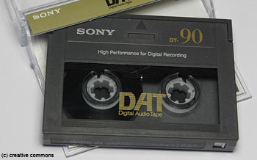
Important Terminologies
In contrast to sequential access memories, such as magnetic tapes, the RAM portion of the term DRAM means that memory accesses take basically the same amount of time no matter what portion of the memory is read.
Cache memory: A small, fast memory that acts as a buffer for a slower, larger memory.
Static Random Access Memory (SRAM): Also memory built as an integrated circuit, but faster and less dense than DRAM.

Slide 37
Abstraction
Instruction Set Architecture (ISA) = Architecture: An abstract interface between the hardware and the lowest-level software that encompasses all the information necessary to write a machine language program that will run correctly, including instructions, registers, memory access, I/O, and so on.
Application Binary Interface (ABI): The user portion of the instruction set plus the operating system interfaces used by application programmers. It defines a standard for binary portability across computers.
An ISA allows computer designers to talk about functions independently from the hardware that performs them.
Computer designers distinguish architecture from an implementation of an architecture along the same lines.
Implementation: Hardware that obeys the architecture abstraction.

Slide 38
A Safe Place for Data
Non-volatile Memory: A form of memory that retains data even in the absence of a power source and that is used to store programs between runs. A DVD disk is non-volatile.
Volatile Memory: Storage, such as DRAM, that retains data only if it is receiving power.
Main/Primary Memory: Memory used to hold programs while they are running; typically consists of DRAM in today’s computers.
Secondary Memory: Non-volatile memory used to store programs and data between runs; typically consists of flash memory in PMDs and magnetic disks in servers.

Slide 39
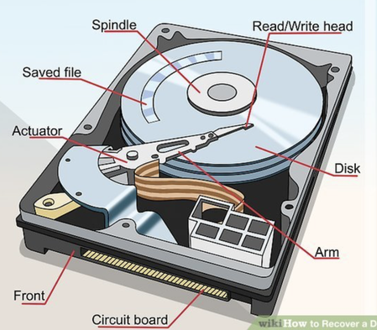
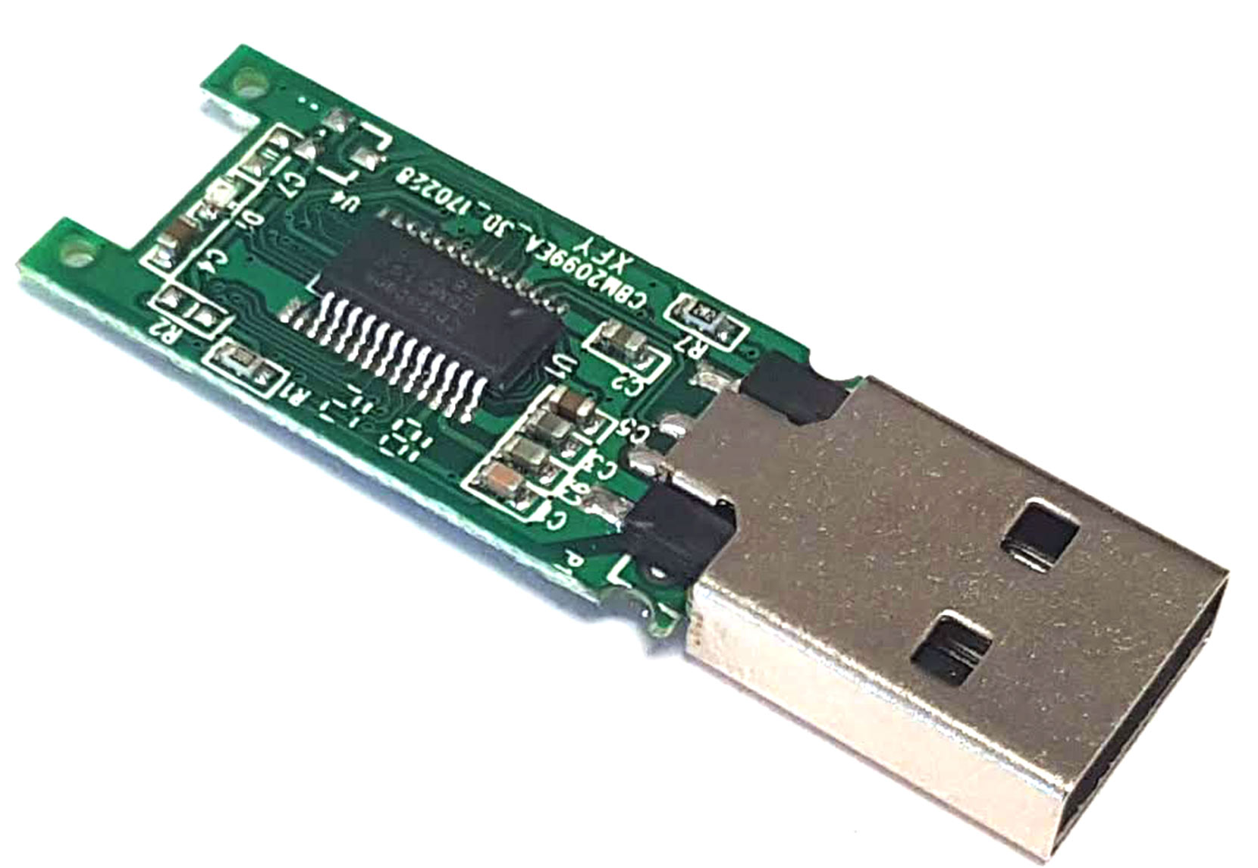
A Safe Place for Data
Magnetic disk Also called hard disk. A form of non-volatile secondary memory composed of rotating platters coated with a magnetic recording material. Because they are rotating mechanical devices, access times are about 5 to 20 ms and cost per Gbyte in 2012 was $0.05 to $0.10.
Flash memory: A non-volatile semiconductor memory. It is cheaper and slower than DRAM but more expensive per bit and faster than magnetic disks.

Slide 40
Communicating with Other Computers
Networked computers have several major advantages:
Communication: Information is exchanged between computers at high speeds.
Resource sharing: Rather than each computer having its own I/O devices, computers on the network can share I/O devices.
Nonlocal access: By connecting computers over long distances, users need not be near the computer they are using.
Local area network (LAN): A network designed to carry data within a geographically confined area, typically within a single building.
Wide area network (WAN): A network extended over hundreds of kilometers that can span a continent.
More on …CPE 562 Computer Networks

Slide 41
Communicating with Other Computers
Networks vary in length and performance.
The cost of communicating data depends on both the speed of communication and the distance that information travels.
For the last 30 years, networks become much more ubiquitous with increased performance.
For example, network based on Ethernet, then Optical communications, then Wireless technology.

Slide 42

Check Yourself
Semiconductor DRAM memory, flash memory, and disk storage differ significantly.
For each technology, list its volatility, approximate relative access time, and approximate relative cost compared to DRAM.

Slide 43
1.5 Technologies for Building Processors and Memory
Processors and memory have improved at an incredible rate.
Transistor: An on/off switch controlled by an electric signal.
Very large-scale integrated (VLSI) circuit: A device containing millions of transistors.
Silicon: A natural element that is a semiconductor.
Semiconductor: A substance that does not conduct electricity well.

Slide 44
Growth of capacity per DRAM chip over time
The y-axis is measured in Kbits (2¹⁰ bits). The DRAM industry quadrupled capacity almost every three years, a 60% increase per year, for 20 years.
In recent years, the rate has slowed down and is somewhat closer to doubling every two to three years.

Slide 45
Manufacturing of Integrated Circuits (ICs)
Begins with silicon, a substance found in sand, which is called a semiconductor.
With a special chemical process, add materials to silicon that allow tiny areas to transform into one of three devices:
Excellent conductors of electricity (using either microscopic copper or aluminum wire)
Excellent insulators from electricity (like plastic or glass)
Areas that can conduct or insulate under specific conditions (as a switch)
https://www.youtube.com/watch?v=bor0qLifjz4&ab_channel=InfineonTechnologiesAG
https://www.youtube.com/watch?v=35jWSQXku74&ab_channel=RobertoMulargia
https://www.youtube.com/watch?v=F2KcZGwntgg&ab_channel=LinasK

Slide 46
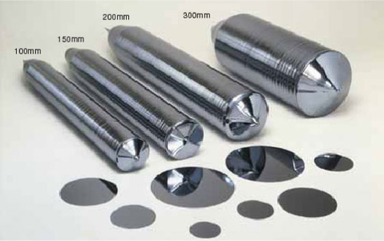
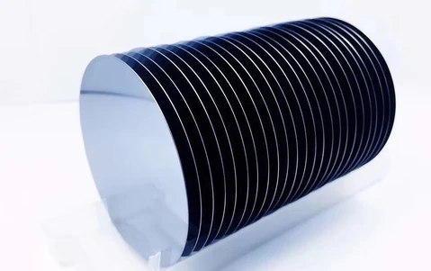
Manufacturing of Integrated Circuits (ICs)
Silicon Crystal Ingot: A rod composed of a silicon crystal that is between 8 and 12 inches in diameter and about 12 to 24 inches long.
Wafer: A slice from a silicon ingot no more than 0.1 inches thick, used to create chips.
Defect: A microscopic flaw in a wafer or in patterning steps that can result in the failure of the die containing that defect.

Slide 47
Manufacturing of Integrated Circuits (ICs)
Die The individual rectangular sections that are cut from a wafer, more informally known as chips.
Yield The percentage of good dies from the total number of dies on the wafer.
Bonding: packaging of the good dies

Slide 48
Cost of Integrated Circuits (ICs)
The main 3 equations are:

Slide 49
Check Yourself
A key factor in determining the cost of an integrated circuit is volume. Which of the following are reasons why a chip made in high volume should cost less?
With high volumes, the manufacturing process can be tuned to a particular design, increasing the yield.
It is less work to design a high-volume part than a low-volume part.
The masks used to make the chip are expensive, so the cost per chip is lower for higher volumes.
Engineering development costs are high and largely independent of volume; thus, the development cost per die is lower with high-volume parts.
High-volume parts usually have smaller die sizes than low-volume parts and therefore, have higher yield per wafer.

Slide 50
1.6 Performance … important/interesting topic
Performance is used to choose between different computers.
However, assessing the performance of computers is challenging.
The capacity, range, and speed for a number of commercial airplanes
Which plane had the best performance?
We would first need to define performance

Slide 51
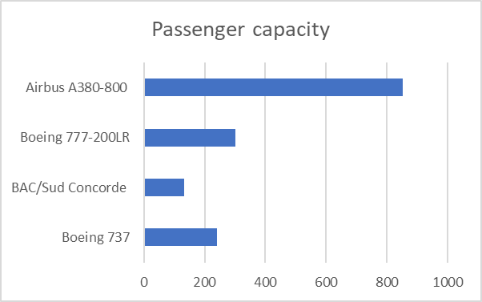
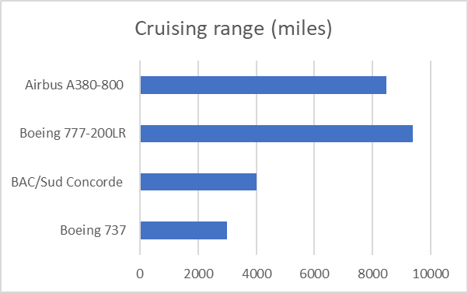
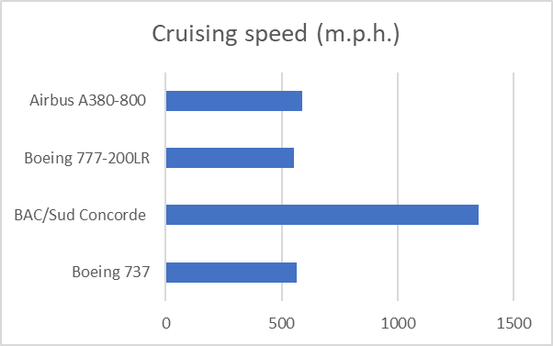
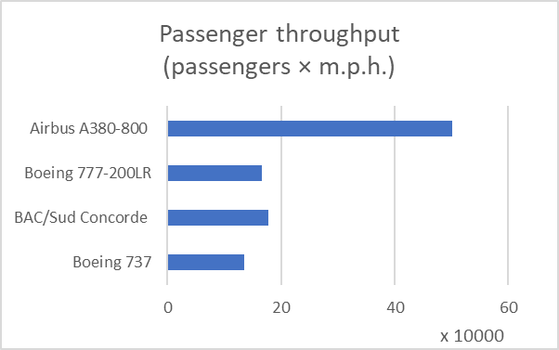
1.6 Performance

Slide 52
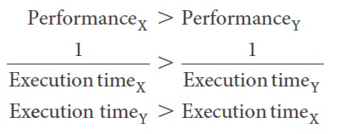
Computer Performance
Response/execution time : The total time required for the computer to complete a task, including disk accesses, memory accesses, I/O activities, operating system overhead, CPU execution time, and so on.
Throughput, also called bandwidth: Another measure of performance, it is the number of tasks completed per unit time.

Slide 53
Measuring Performance
Time is the measure of computer performance: the computer that performs the same amount of work in the least time is the fastest.
wall clock time, response time, or elapsed time: These terms mean the total time to complete a task, including disk accesses, memory accesses, input/output(I/O)activities, operating system overhead everything.
For shared computers, the system may try to optimize throughput
CPU execution time, also called CPU time: The actual time the CPU spends computing for a specific task (user + system).
User CPU time: The CPU time spent in a program itself.
System CPU time: The CPU time spent in the operating system performing tasks on behalf of the program.

Slide 54
Understanding Program Performance
Different applications are sensitive to different aspects of the performance of a computer system.
Performance can be measured by total elapsed time, throughput, response time.
Clock cycle also called tick, clock tick, clock period, clock, or cycle. The time for one clock period, usually of the processor clock, which runs at a constant rate.

Slide 55
CPU Performance and Its Factors
So, the hardware designer can improve performance by reducing the number of clock cycles required for a program or the length of the clock cycle.
So, many techniques that decrease the number of clock cycles may also increase the clock cycle time.

Slide 56
Improving Performance

Slide 57
Instruction Performance
The previous equations did not include any reference to the number of instructions needed for the program.
Execution time equals the number of instructions executed multiplied by the average time per instruction
Clock cycles per instruction (CPI): Average number of clock cycles per instruction for a program or program fragment.

Slide 58
Using the Performance Equation

Slide 59
The Classic CPU Performance Equation
Instruction count: The number of instructions executed by the program.
We can use these formulas to compare two different implementations or to evaluate a design alternative if we know its impact on these three parameters.

Slide 60
Comparing Code Segments

Slide 61
Computer Performance

Slide 62
Computer Performance
We can measure the CPU execution time by running the program, and the clock cycle time is usually published as part of the documentation for a computer.
The instruction count and CPI can be more difficult to obtain.

Slide 63
Understanding Program Performance

Slide 64
Understanding Program Performance
Although you might expect that the minimum CPI is 1.0, as we’ll see in Chapter 4, some processors fetch and execute multiple instructions per clock cycle.
To reflect that approach, some designers invert CPI to talk about IPC, or instructions per clock cycle.
If a processor executes on average two instructions per clock cycle, then it has an IPC of 2 and hence a CPI of 0.5.
Although clock cycle time has traditionally been fixed, to save energy or temporarily boost performance, today’s processors can vary their clock rates, so we would need to use the average clock rate for a program.
For example, the Intel Core i7 will temporarily increase clock rate by about 10% until the chip gets too warm. Intel calls this Turbo mode.

Slide 65
Check Yourself

Slide 66
1.4 The Power Wall
The dominant technology for integrated circuits is called CMOS (complementary metal oxide semiconductor).
For CMOS, the primary source of energy consumption is so-called dynamic energy that is, energy that is consumed when transistors switch states from 0 to 1 and vice versa.
Both clock rate and power increased rapidly for decades and then flattened off recently.
Recent slowing is because we have run into the practical power limit for cooling commodity microprocessors.

Slide 67
The Power Wall
The dynamic energy depends on the capacitive loading of each transistor and the voltage applied:
This equation is the energy of a pulse during the logic transition of 0 → 1 → 0 or 1 → 0 → 1. The energy of a single transition is then
The power required per transistor is just the product of energy of a transition and the frequency of transitions:
Frequency switched is a function of the clock rate.
The capacitive load per transistor is a function of both the number of transistors connected to an output (called the fanout) and the technology, which determines the capacitance of both wires and transistors.

Slide 68
The Power Wall
Q: As shown in Figure 1.16, the clock rates grow by a factor of 1000 while power increased by only a factor of 30?
A: Energy and thus power can be reduced by lowering the voltage, which occurred with each new generation of technology, and power is a function of the voltage squared.
Typically, the voltage was reduced about 15% per generation. In 20 years, voltages have gone from 5 V to 1 V, which is why the increase in power is only 30 times.

Slide 69
Example- Relative Power
Suppose we developed a new, simpler processor that has 85% of the capacitive load of the more complex older processor. Further, assume that it can adjust voltage so that it can reduce voltage 15% compared to processor B, which results in a 15% shrink in frequency. What is the impact on dynamic power?

Slide 70
The Power Wall - Elaboration
Elaboration: Although dynamic energy is the primary source of energy consumption in CMOS, static energy consumption occurs because of leakage current that flows even when a transistor is off.
In servers, leakage is typically responsible for 40% of the energy consumption. Thus, increasing the number of transistors increases power dissipation, even if the transistors are always off.
A variety of design techniques and technology innovations are being deployed to control leakage, but it’s hard to lower voltage further.

Slide 71
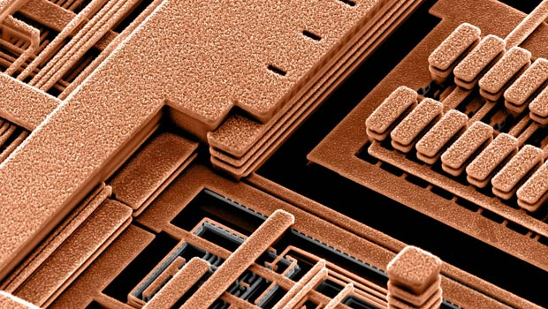
The Power Wall - Elaboration
Elaboration: Power is a challenge for integrated circuits for two reasons.
First, power must be brought in and distributed around the chip; modern microprocessors use hundreds of pins just for power and ground! Similarly, multiple levels of chip interconnect are used for power and ground distribution to portions of the chip.
Second, power is dissipated as heat and must be removed. Server chips can burn more than 100 watts, and cooling the chip and the surrounding system is a major expense in warehouse scale computers (see Chapter 6).
https://www.youtube.com/watch?v=lBeepqQBpvU&ab_channel=Microsoft

Slide 72
1.8 The Switch from Uniprocessors to Multiprocessors
The power limit has forced a dramatic change
in the design of microprocessors.
Rather than continuing to decrease the response time of one program running on the single processor, as of 2006 multiple processors per chip is introduced, where the benefit is often more on throughput than on response time.
Previously, programmers could rely on innovations in hardware, architecture, and compilers to increase performance of their programs.
Today, programmers need to rewrite their programs to get significant improvement in response time based on multiple processors.

Slide 73
The Switch from Uniprocessors to Multiprocessors
Growth in processor performance since the mid-1980s

Slide 74
Why it is hard to explicitly write parallel programs?
Scheduling: break up the task so that each core had something to do at the same time.
Load balancing: The cores have same amount of work
time for synchronization:
Overhead for communication between the parties:

Slide 75
1.9 Real Stuff: Benchmarking the Intel Core i7
Workload: A set of programs run on a computer that is either the actual collection of applications run by a user or constructed from real programs to approximate such a mix.
A typical workload specifies both the programs and the relative frequencies.
To evaluate two computer systems, a user would simply compare the execution time of the workload on the two computers.
Benchmarks: programs specifically chosen to measure performance.
SPEC (System Performance Evaluation Cooperative) is an effort funded and supported by a number of computer vendors to create standard sets of benchmarks for modern computer systems.
In 1989, SPEC originally created a benchmark set focusing on processor performance (now called SPEC89), which has evolved through five generations.

Slide 76
Real Stuff: Benchmarking the Intel Core i7
The latest is SPEC CPU2006, which consists of a set of 12 integer benchmarks (CINT2006) and 17 floating-point benchmarks (CFP2006).
Dividing the execution time of a reference processor by the execution time of the evaluated computer normalizes the execution time measurements; this normalization yields a measure, called the SPECratio.

Slide 77
SPECINTC2006 benchmarks running on a 2.66 GHz Intel Core i7

Slide 78
1.10 Fallacies and Pitfalls
Fallacies: Commonly held misconceptions
Pitfalls: Easily made mistakes.
Pitfall: Expecting the improvement of one aspect of a computer to increase overall performance by an amount proportional to the size of the improvement.
Fallacy: Computers at low utilization use little power.
Fallacy: Designing for performance and designing for energy efficiency are unrelated goals.
Pitfall: Using a subset of the performance equation as a performance metric.

Slide 79
Amdahl’s Law
Amdahl’s Law :A rule stating that the performance enhancement possible with a given improvement is limited by the amount that the improved feature is used.
The execution time of the program after making the improvement is given by the following simple equation known as Amdahl’s Law:

Slide 80
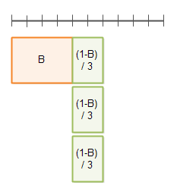
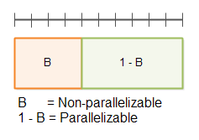
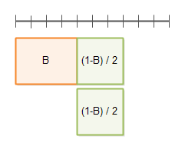

Amdahl’s Law
Amdahl’s Law :A rule stating that the performance enhancement possible with a given improvement is limited by the amount that the improved feature is used.
4
2
6
4
3
4

Slide 81

Amdahl’s Law
Improving an aspect of a computer and expecting a proportional improvement in overall performance
$$T_{improved}=\frac{T_{affected}}{improvement factor}+T_{unaffected}$$
Example: multiply accounts for 80s/100s
How much improvement in multiply performance to get 5× overall?
Can’t be done!
Corollary: make the common case fast

Slide 82
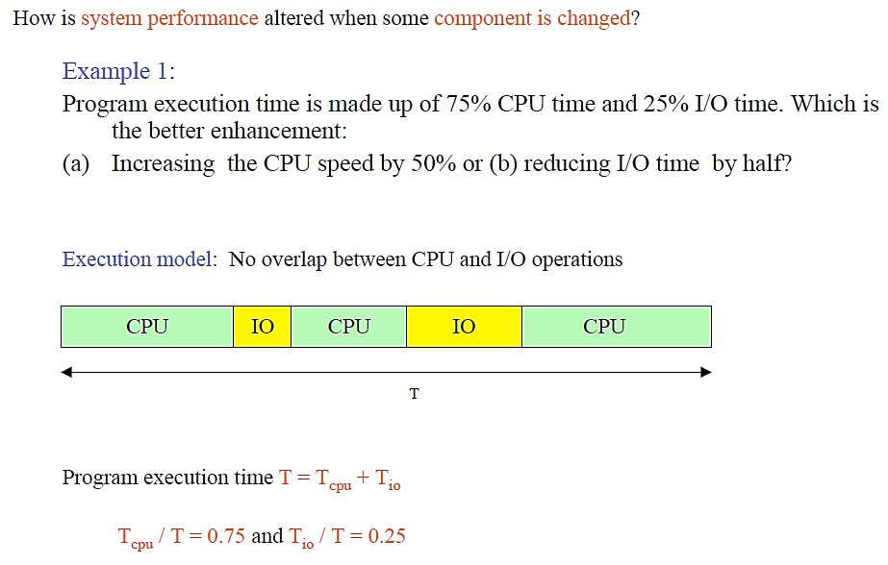
Amdahl’s Law

Slide 83
Amdahl’s Law

Slide 84
Amdahl’s Law

Slide 86
RISC vs –CISC
RISC-V, ARM, MIPS

